Slide 1

Impacts of Car Features On Price and Profitability
Saroj Kumar Mahto​

Slide 2
Project Description
The automotive industry has been rapidly evolving over the past few decades, with a growing focus on fuel efficiency, environmental sustainability, and technological innovation. With increasing competition among manufacturers and a changing consumer landscape, it has become more important than ever to understand the factors that drive consumer demand for cars.
In recent years, there has been a growing trend towards electric and hybrid vehicles and increased interest in alternative fuel sources such as hydrogen and natural gas. At the same time, traditional gasoline-powered cars remain dominant in the market, with varying fuel types and grades available to consumers.

Slide 3
Project Description
In this Project, the client has asked How can a car manufacturer optimize pricing and product development decisions to maximize profitability while meeting consumer demand? As a Data Analyst, our work is about analyzing patterns in the various Car features to understand the factors that drive consumer demands for Cars. These insights will be helpful for Car manufacturers, dealers and other stakeholders to determine the important factors to boost sales of Cars.

Slide 4
Approach Taken By Me
Importing and understand-ing the data
Perform the various analysis to derive insights
Making the report and explaining the project
Cleaning the dataset as per the requirement.
Visualizing the outputs in charts and graphs

Slide 5




Tech Stack Used
MS EXCEL
MS POWERPOINT
TABLEAU
OBS STUDIO

Slide 6

Task Analysis

Slide 7
Task 1
Insights
Performance market category has the number of the car models followed by Luxury.
Flex Fuel market category has the highest average popularity score followed by Hybrid.

Slide 8
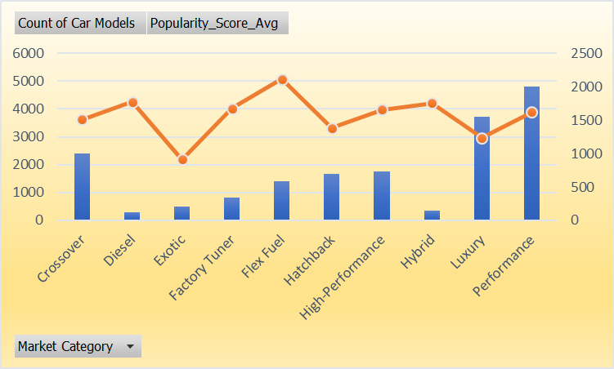
Task 1.B

Slide 9
Task 2

Slide 10
Task 3
SUMMARY OUTPUT
Regression Statistics
Multiple R | 0.796457185
R Square | 0.634344048
Adjusted R Square | 0.634058646
Standard Error | 45039.55436
Observations | 11198
ANOVA
 | df | SS | MS | F | Significance F
Regression | 7 | 3.9383E+13 | 5.62615E+12 | 2773.467478 | 0
Residual | 11191 | 2.27016E+13 | 2028561457
Total | 11198 | 6.20847E+13
 | Coefficients | Standard Error | t Stat | P-value | Lower 95% | Upper 95% | Lower 95.0% | Upper 95.0%
Intercept | 0 | #N/A | #N/A | #N/A | #N/A | #N/A | #N/A | #N/A
Year | -46.72674104 | 2.037764687 | -22.930391 | 9.4435E-114 | -50.72111844 | -42.73236363 | -50.72111844 | -42.73236363
Engine HP | 313.3220592 | 6.182055836 | 50.68250231 | 0 | 301.2041418 | 325.4399766 | 301.2041418 | 325.4399766
Engine Cylinders | 7380.361261 | 454.3811207 | 16.24266706 | 1.1772E-58 | 6489.694299 | 8271.028223 | 6489.694299 | 8271.028223
Number of Doors | -4645.18183 | 496.682935 | -9.352408757 | 1.01946E-20 | -5618.767793 | -3671.595868 | -5618.767793 | -3671.595868
highway MPG | 1324.173618 | 165.0564479 | 8.022550073 | 1.13898E-15 | 1000.633932 | 1647.713303 | 1000.633932 | 1647.713303
city mpg | 47.30140426 | 140.655358 | 0.336292943 | 0.736656276 | -228.4078509 | 323.0106594 | -228.4078509 | 323.0106594
Popularity | -3.386876838 | 0.295788321 | -11.45033997 | 3.44855E-30 | -3.966674003 | -2.807079673 | -3.966674003 | -2.807079673

Slide 12
Task 4

Slide 13
Task 5
y = -29990x+43.5284

Slide 14

Dashboard
Link Of The Dashboard
Analyzing the Impact of Car Features on Price and Profitability

Slide 15
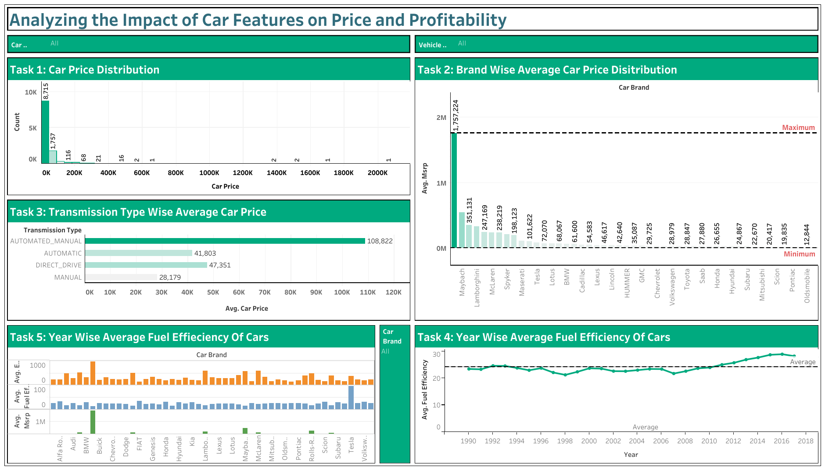

Slide 16

Thank You
Link:
https://drive.google.com/drive/folders/1LH1Ci3VoOI-xXFulH_E6zpf3REQPvsX9?usp=sharing

